Slide 1
Arduino Basics
Ардуино осноВИ
Част 8
gevelichkov@gmail.com

Slide 2
Съдържание
Тежки товари
Релета и принцип на действие
Свързване на релета и функционалност
Правотокови мотори
Реле модул
Управление на правотоков мотор с L293
Серво мотори
Стъпкови мотори

Slide 3
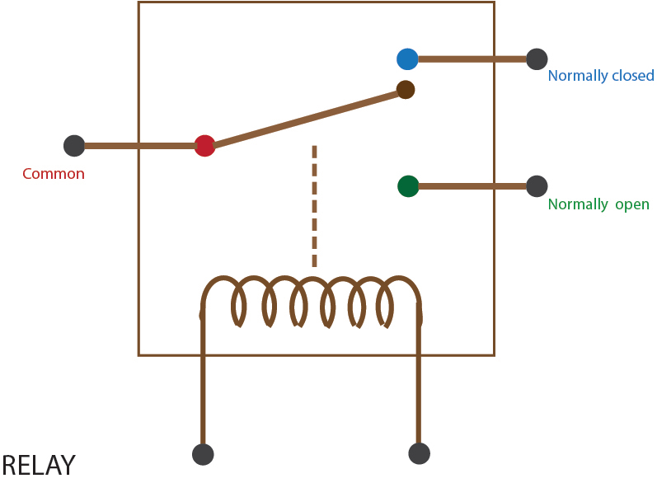
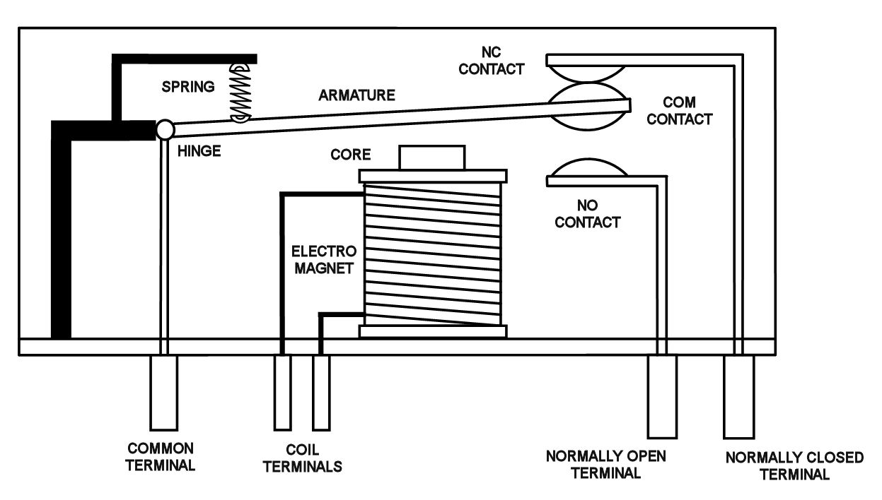
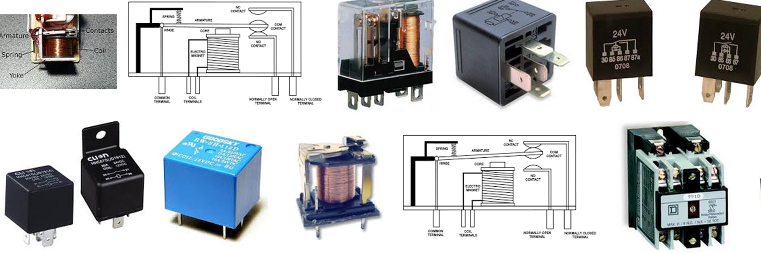
Релета принцип на действие
https://www.youtube.com/watch?v=1_YfuH_AcxQ

Slide 4
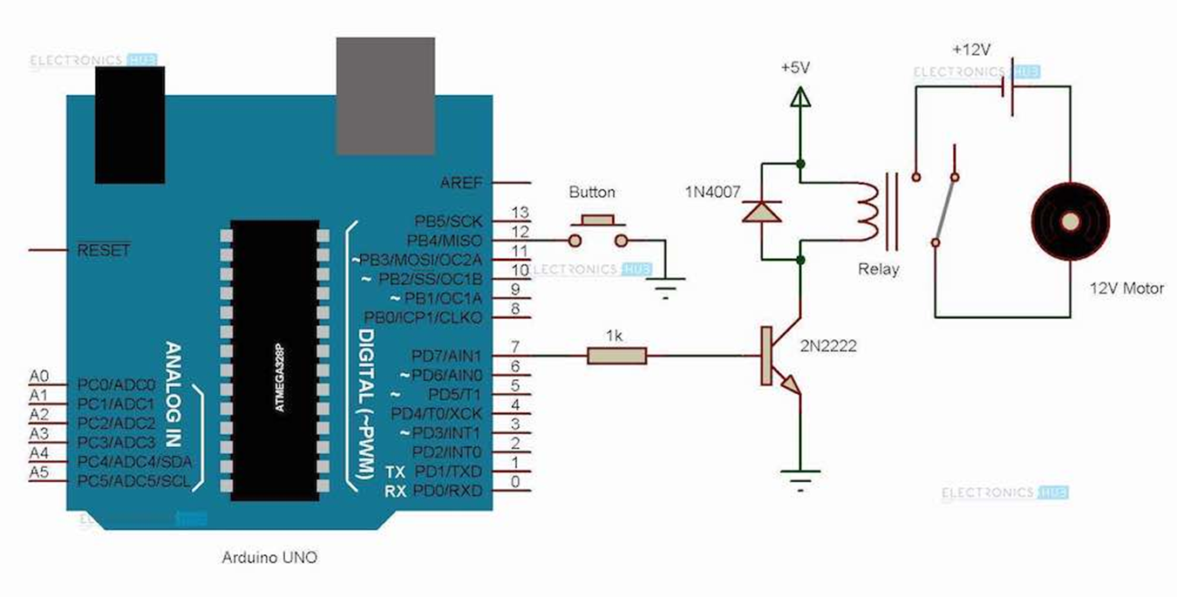
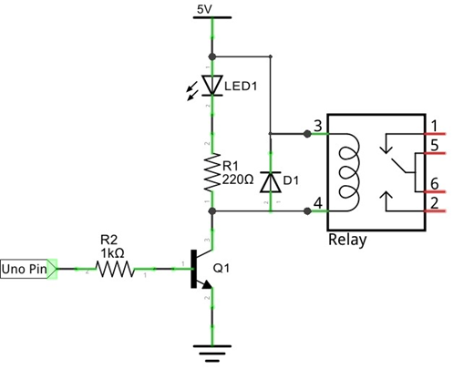
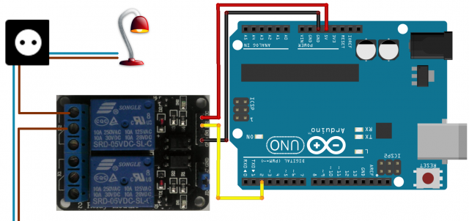
Принцип на свързване и функционалност

Slide 5
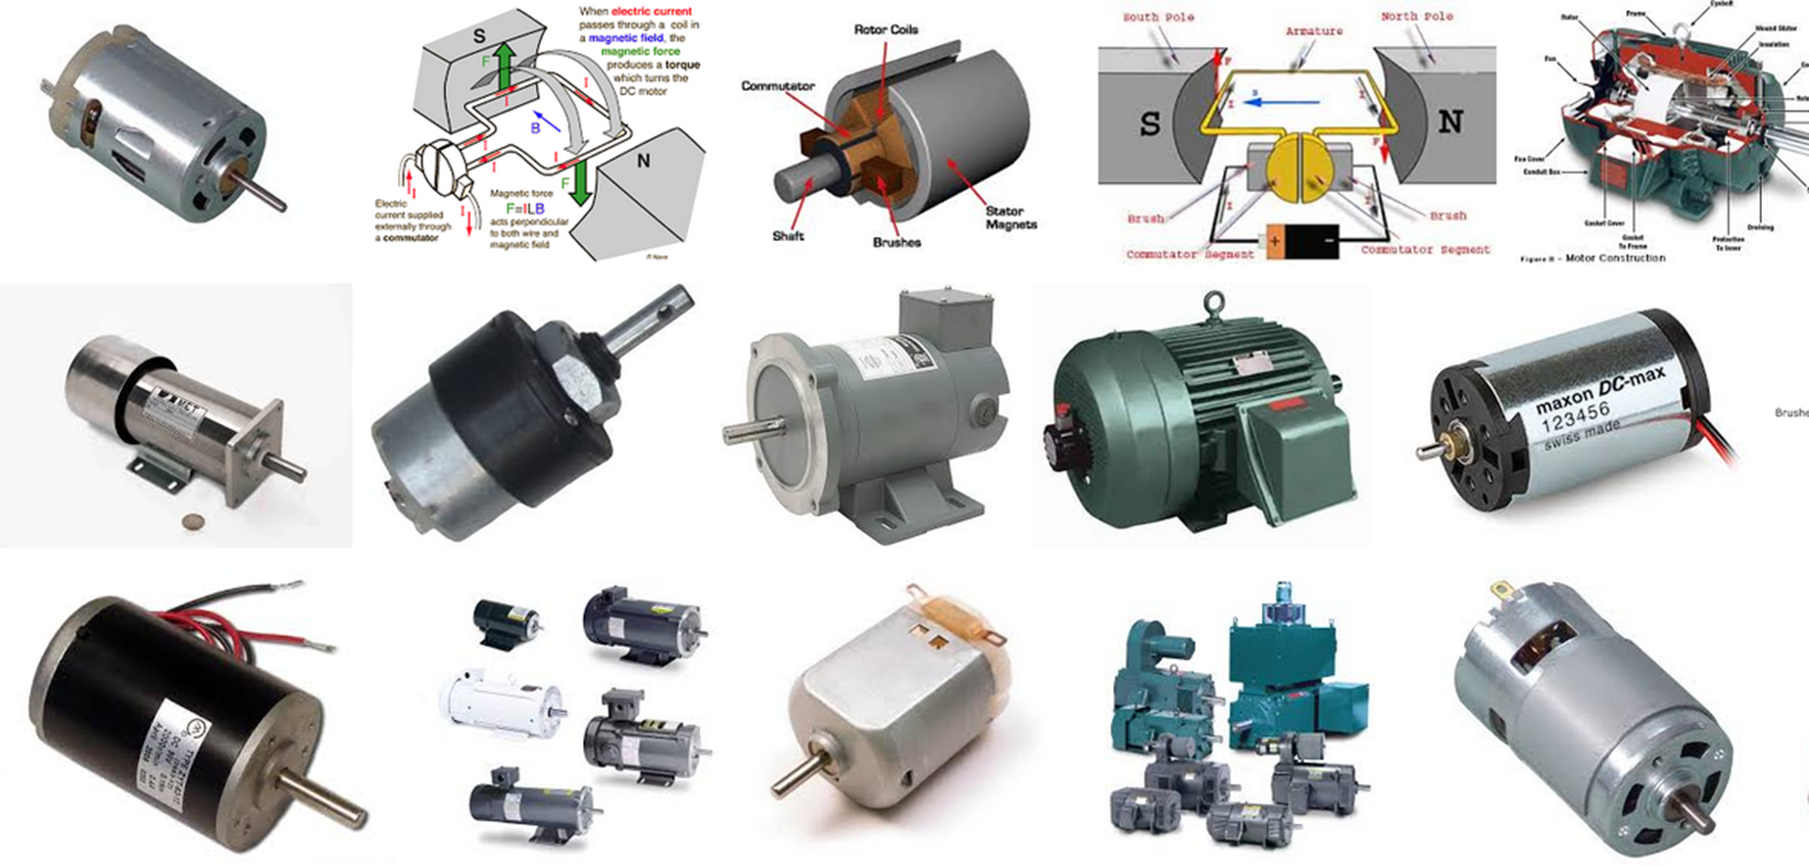
Правотокови мотори

Slide 6
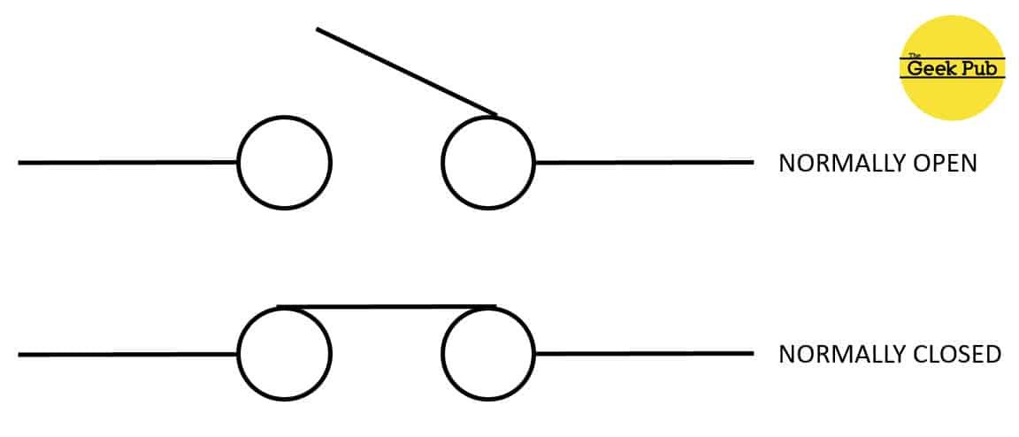

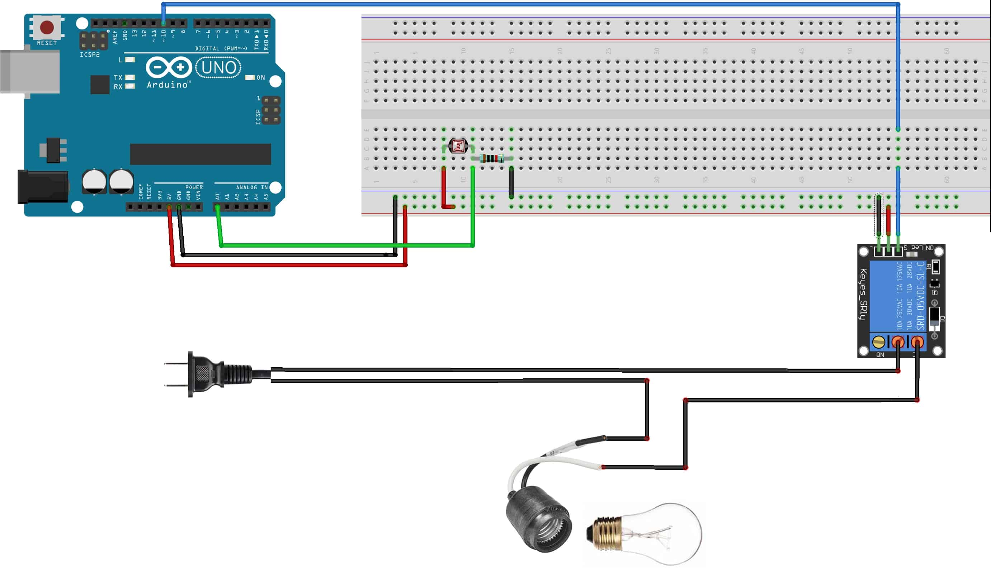
Реле модул

Slide 7
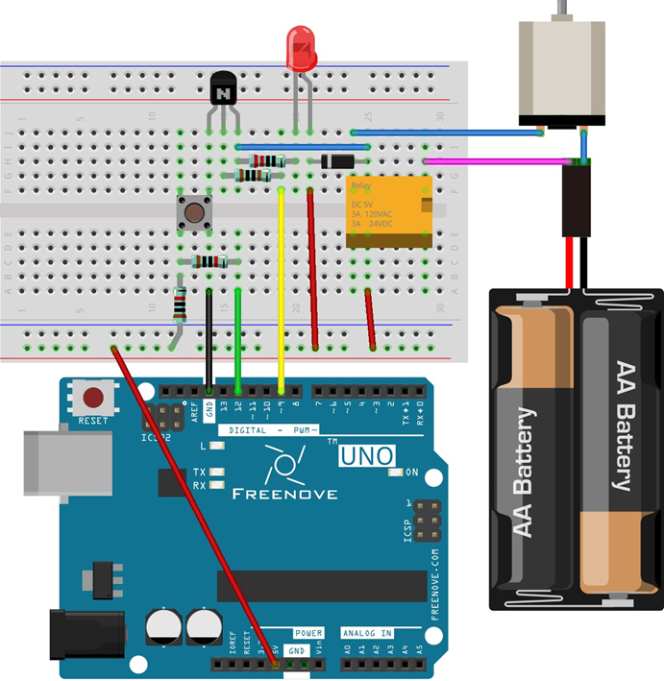
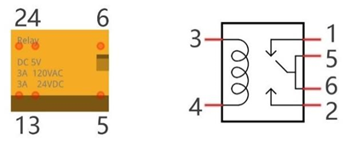
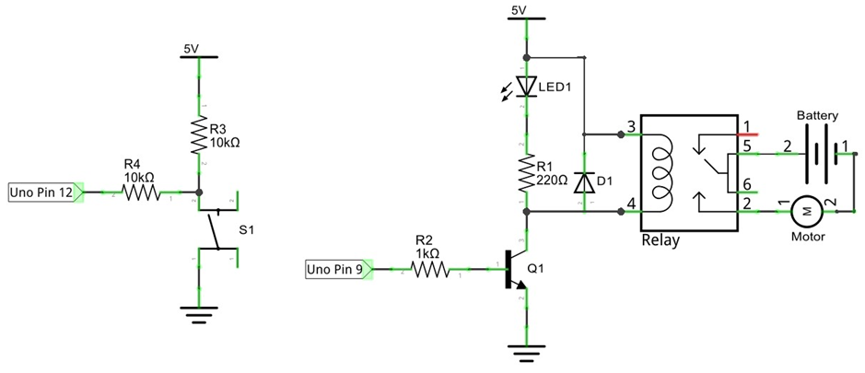
Задача 1

Slide 8
Код Задача 1
int relayPin = 9; // the number of the relay pin
int buttonPin = 12; // the number of the push button pin
int buttonState = HIGH; // Record button state, and initial the state to high level
int relayState = LOW; // Record relay state, and initial the state to low level
int lastButtonState = HIGH; // Record the button state of last detection
long lastChangeTime = 0; // Record the time point for button state change
void setup() {
pinMode(buttonPin, INPUT); // Set push button pin into input mode
pinMode(relayPin, OUTPUT); // Set relay pin into output mode
digitalWrite(relayPin, relayState); // Set the initial state of relay into "off"
Serial.begin(9600); // Initialize serial port,and set baud rate to 9600
}
void loop() {
int nowButtonState = digitalRead(buttonPin); // Read current state of button pin
// If button pin state has changed, record the time point
if (nowButtonState != lastButtonState) {
lastChangeTime = millis();
}
// If button state changes, and stays stable for a while, then it should have skipped the bounce area
if (millis() - lastChangeTime > 10) {
if (buttonState != nowButtonState) { // Confirm button state has changed
buttonState = nowButtonState;
if (buttonState == LOW) { // Low level indicates the button is pressed
relayState = !relayState; // Reverse relay state
digitalWrite(relayPin, relayState); // Update relay state
Serial.println("Button is Pressed!");
}
else { // High level indicates the button is released
Serial.println("Button is Released!");
}
}
}
lastButtonState = nowButtonState; // Save the state of last button
}

Slide 9
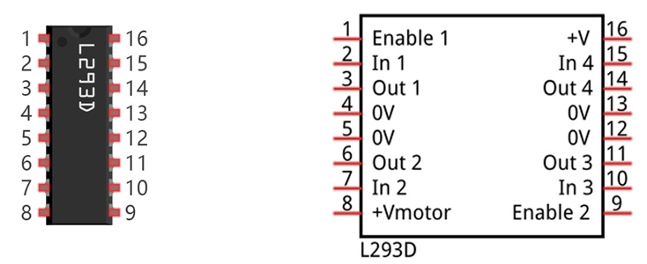
Драйвер(контролер) за управление на мотор
Pin name | Pin number | Description
In x | 2, 7, 10, 15 | Channel x digital signal input pin
Out x | 3, 6, 11, 14 | Channel x output pin, input high or low level according to In x pin, get connected to +Vmotor or 0V
Enable1 | 1 | Channel 1 and channel 2 enable pin, high level enable
Enable2 | 9 | Channel 3 and channel 4 enable pin, high level enable
0V | 4, 5, 12, 13 | Power cathode (GND)
+V | 16 | Positive electrode (VCC) of power supply, supply voltage 4.5~36V
+Vmotor | 8 | Positive electrode of load power supply, provide power supply for the Out pin x, the supply voltage is +V~36V

Slide 10
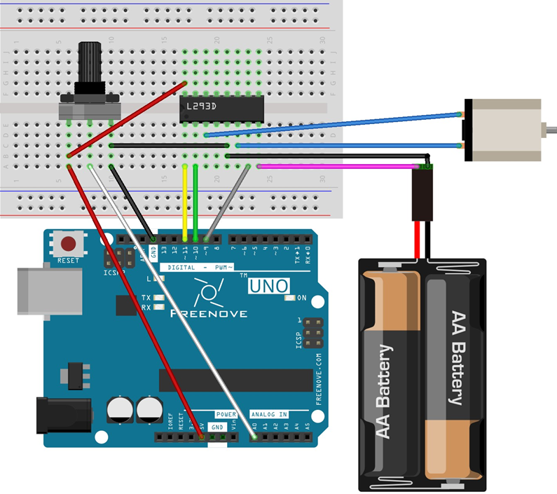
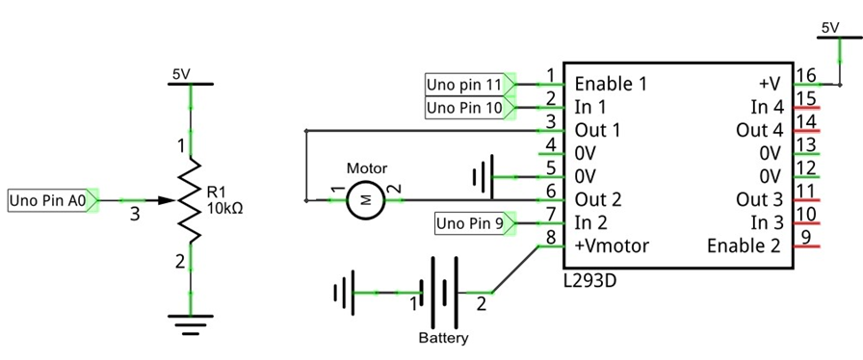
Задача 2 - L293d

Slide 11
КОд задача 2 с l293d
int in1Pin = 10; // Define L293D channel 1 pin
int in2Pin = 9; // Define L293D channel 2 pin
int enable1Pin = 11; // Define L293D enable 1 pin
boolean rotationDir; // Define a variable to save the motor's rotation direction, true and false are represented by positive rotation and reverse rotation.
int rotationSpeed; // Define a variable to save the motor rotation speed
void setup() {
// Initialize the pin into an output mode:
pinMode(in1Pin, OUTPUT);
pinMode(in2Pin, OUTPUT);
pinMode(enable1Pin, OUTPUT);
}
void loop() {
int potenVal = analogRead(A0); // Convert the voltage of rotary potentiometer into digital
// Compare the number with value 512, if more than 512, clockwise rotates, otherwise, counter clockwise rotates
rotationSpeed = potenVal - 512;
if (potenVal > 512)
rotationDir = true;
else
rotationDir = false;
// Calculate the motor speed, the far number of deviation from the middle value 512, the faster the control speed will be
rotationSpeed = abs(potenVal - 512);
// Control the steering and speed of the motor
driveMotor(rotationDir, map(rotationSpeed, 0, 512, 0, 255));
}
void driveMotor(boolean dir, int spd) {
// Control motor rotation direction
if (rotationDir) {
digitalWrite(in1Pin, HIGH);
digitalWrite(in2Pin, LOW);
}
else {
digitalWrite(in1Pin, LOW);
digitalWrite(in2Pin, HIGH);
}
// Control motor rotation speed
analogWrite(enable1Pin, constrain(spd, 0, 255));
}

Slide 12
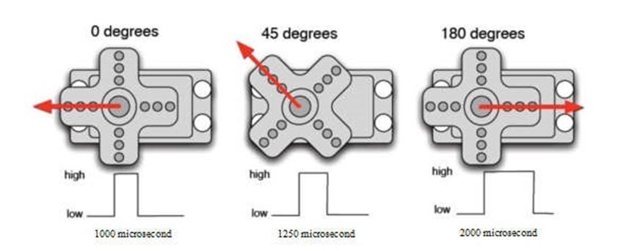
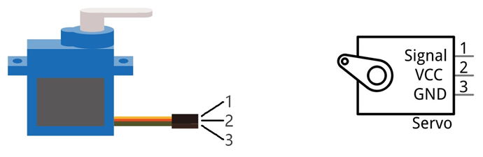
Серво мотори
High level time | Servo angle
0.5ms | 0 degree
1ms | 45 degree
1.5ms | 90 degree
2ms | 135 degree
2.5ms | 180 degree

Slide 13
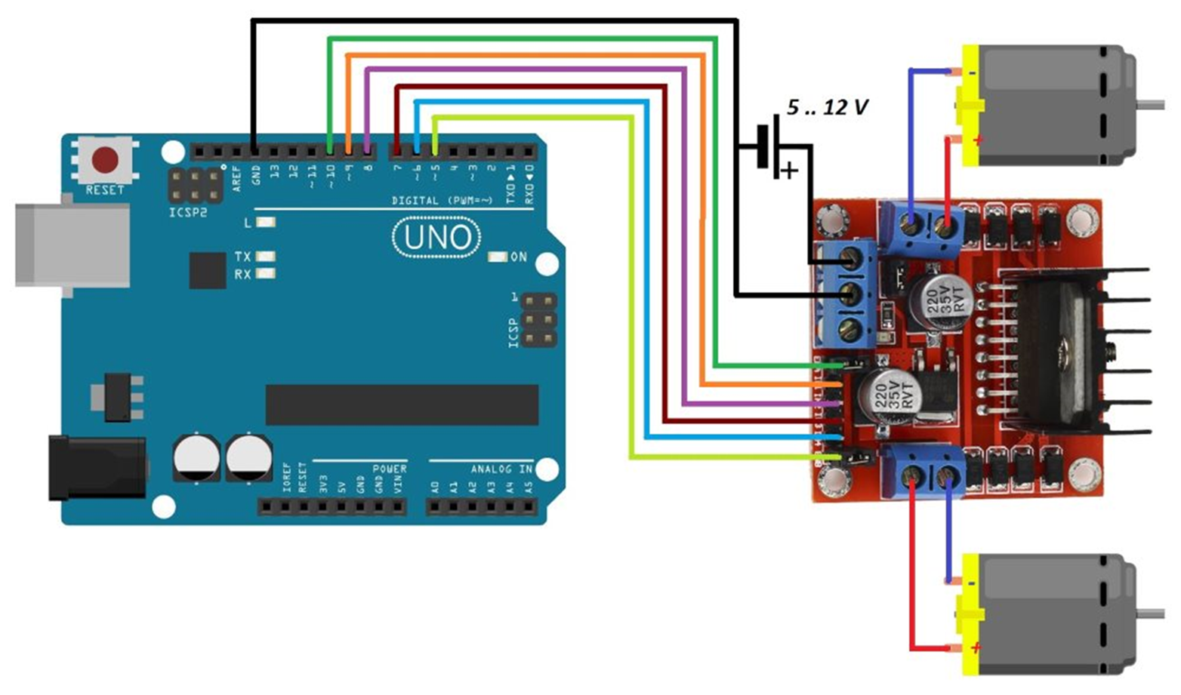
Управление с L298N

Slide 14
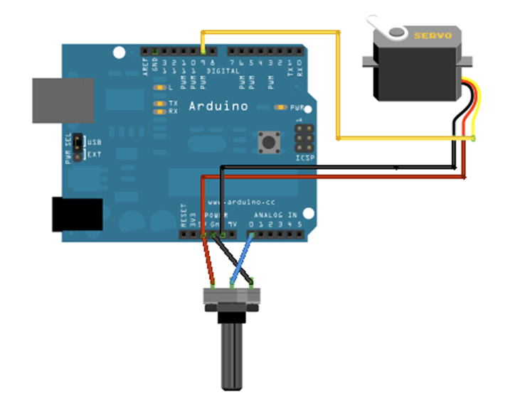
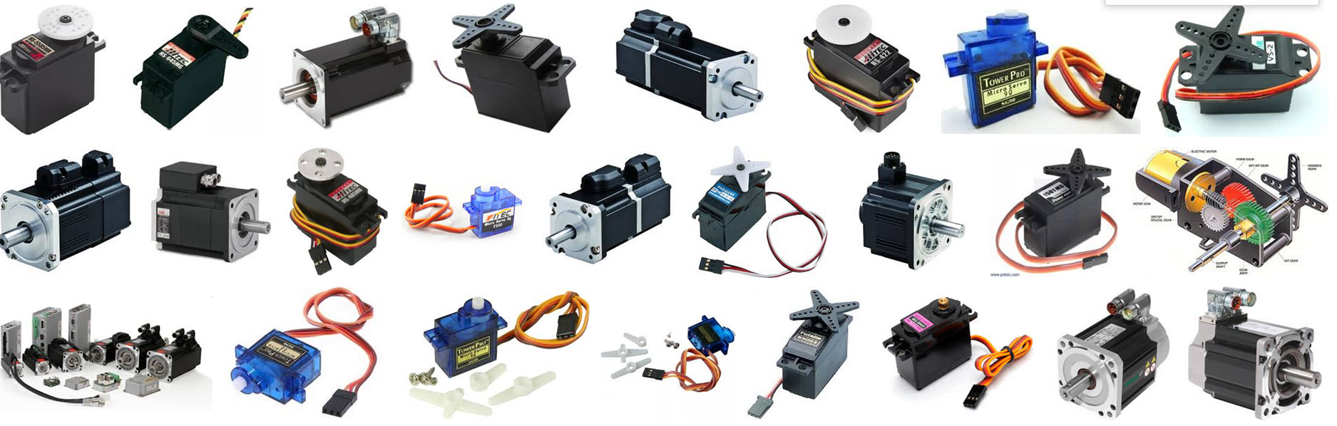
Серво мотори

Slide 15
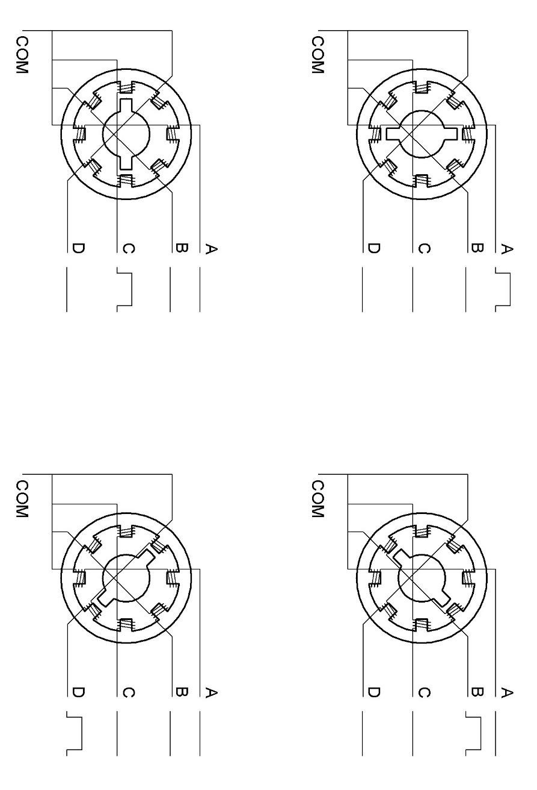
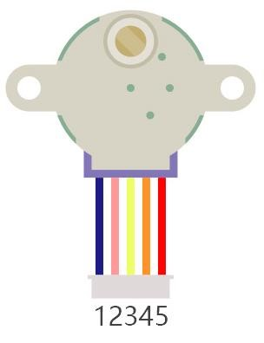
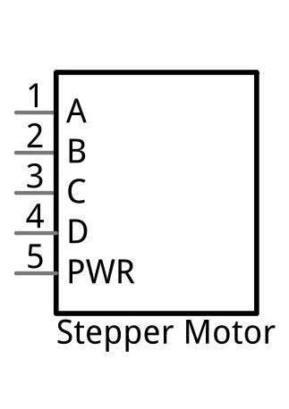
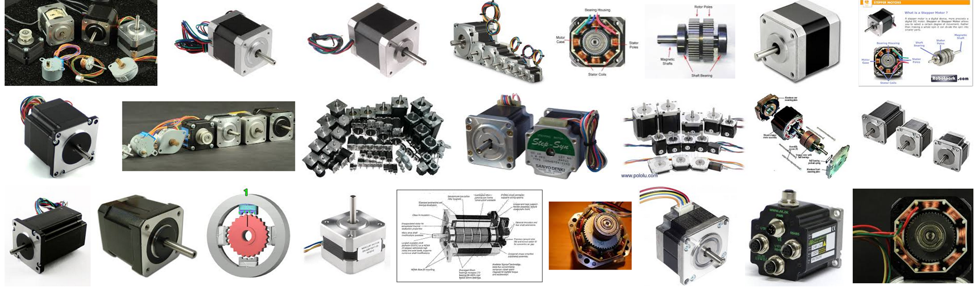
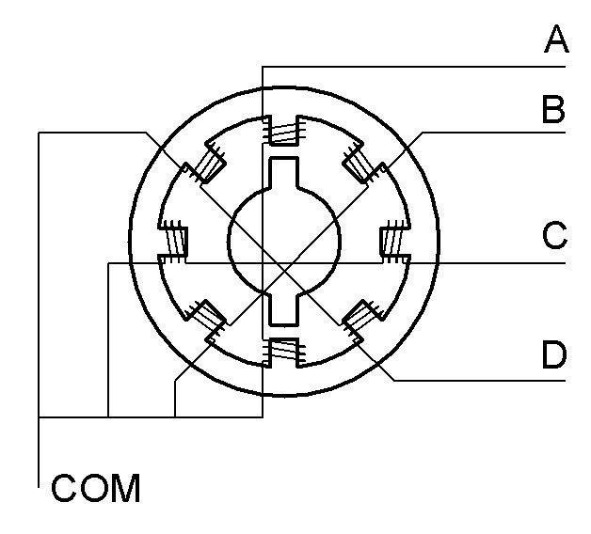
стъпкови мотори

Slide 16
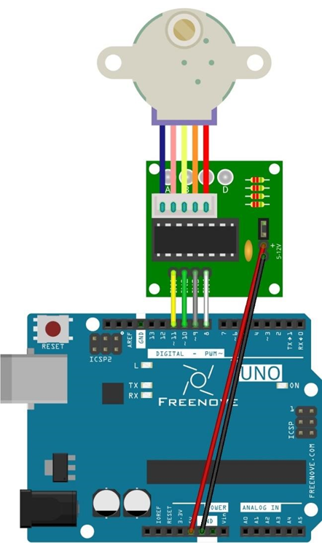
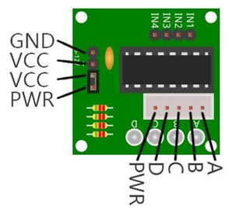
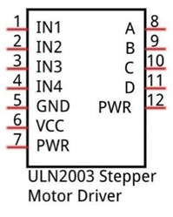
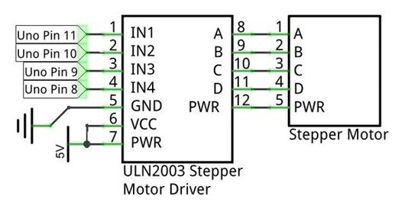
Управление на стъпковмотор с ULN2003

Slide 17
Полезни линкове
https://www.arduino.cc/en/tutorial/stepperSpeedControl
https://www.arduino.cc/en/Tutorial/Knob
http://playground.arduino.cc/Main/RotaryEncoders

Slide 18

Поздравления ! ! ! вече сте осем крачкИ напред ;)

Slide 19
ПРавила за безопасност ! ! !

